Slide 1
Unemployment Analysis in the city of Cancun Mexico
Adolfo Camacho, March 2020

Slide 2
Predicting employment in a giving zone in Cancun, Mexico
It is useful to know the differences amongst the zones in the city to find out which factors are determinant
The venues downloaded from Foursquare resulted insufficient, so it was preferred to downloaded this information from the Mexican government
The people of Cancun or Mexican government officials could be interested in the results of this project

Slide 3
Data selection and data cleaning
5 different datasets were downloaded, one for each independent variables of the models; total population, holders of BA degrees 25 years and above, people with employment, no vacant housing, people with government health insurance.
The coordinates of this AGEBs were retrieved for another source of the government, from the same agency INEGI The queries in this site are presented as lists, these lists were segmented in rows for every location, the data was transposed and only the useful information were filtered
For the purpose of having only one dataframe, all the sources were merged, all the rows with missing values were drop from the final table of data

Slide 4
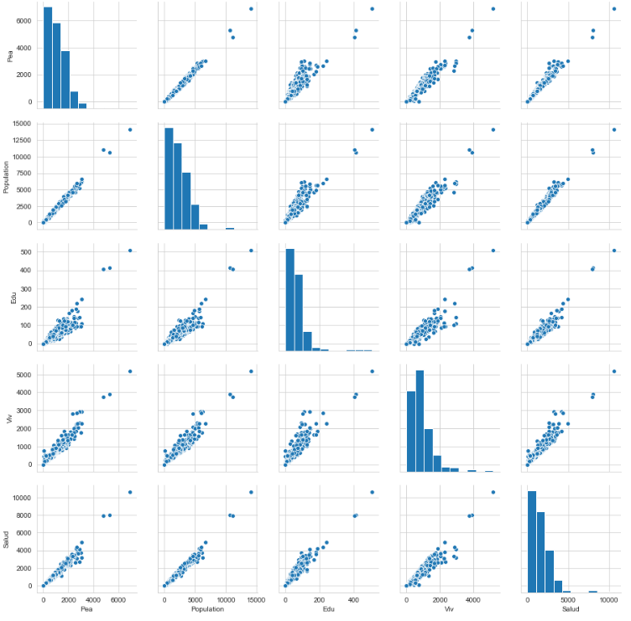
Exploratory Data Analysis Target and independent variables

Slide 5
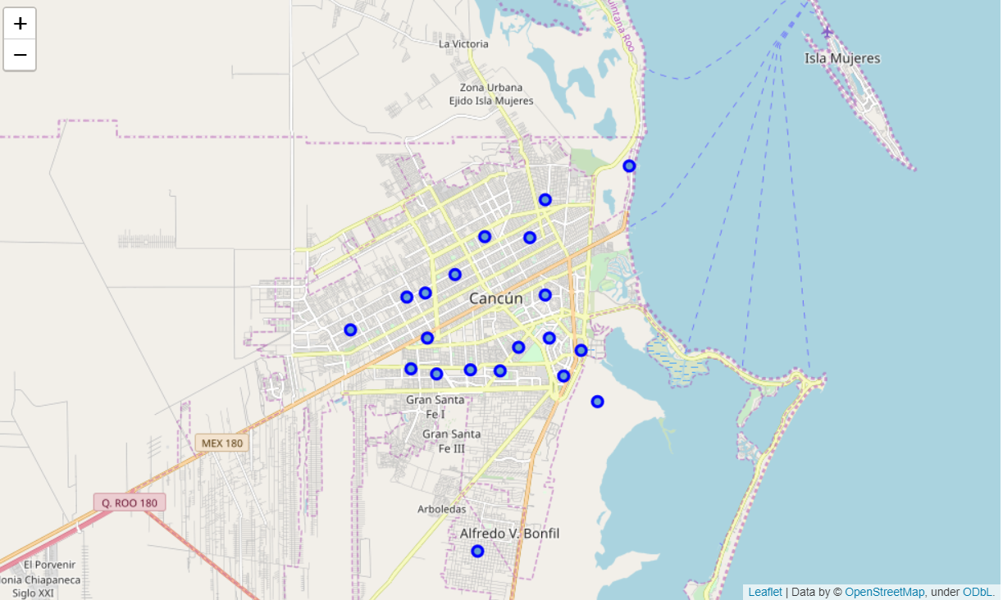
Foursquare points

Slide 6
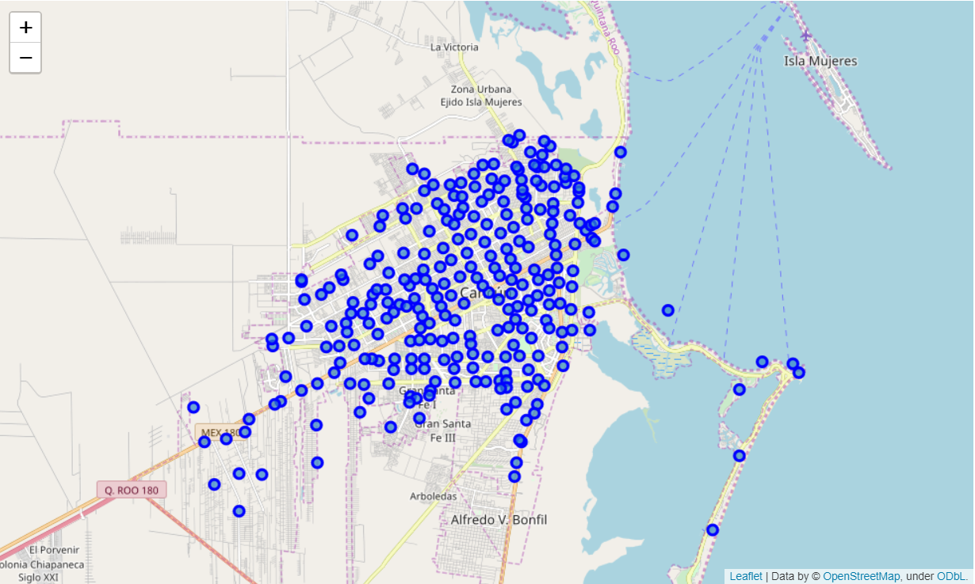
Mexican government data agency INEGI points

Slide 7
Models – Predicted Modelling
Linear Regression
K means Analysis with Frequencies . Foursquare
K means Analysis, with independent variables from INEGI
Linear regression with dummy variables from labels of classification variable

Slide 8
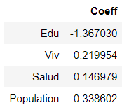
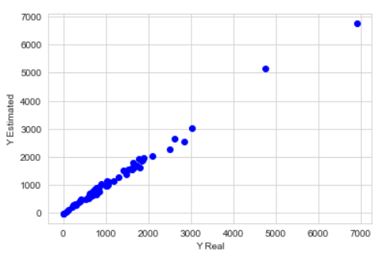

Linear Regression
$$\hat{y}= −28.334−1.36 Education+0.219 Housing+0.146 Health+0.3386 TotPop$$
Metrics
R – Squared 0.9914
MAE 76.329
MSE 11417.394
RSME 106.852

Slide 9
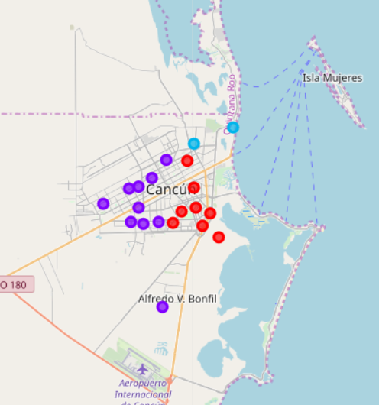
K means Analysis k=3

Slide 10
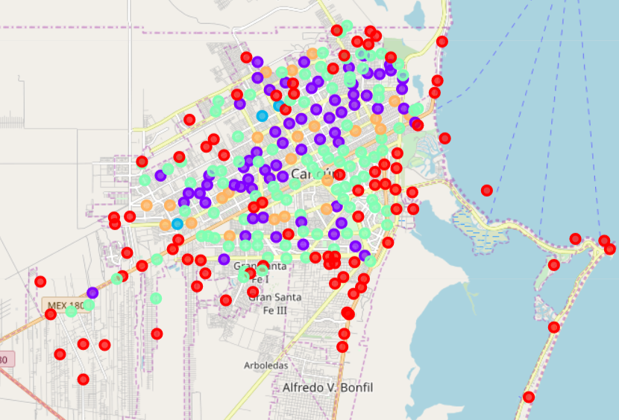
K mean analysis INEGI k=5

Slide 11
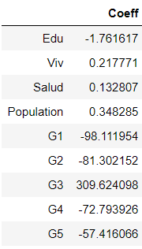
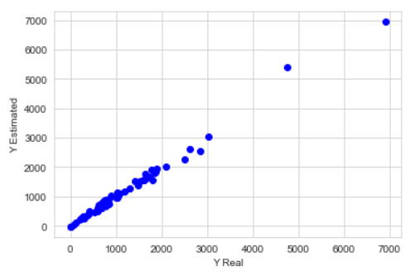

Linear Regression with k –means labels
$$\hat{y}= 74.473−1.76 Education+0.217 Housing+0.132 Health+0.3482 TotPop−98.1 G1+ 81.3 G2+309.62 G3−72.79 G4−57.41 G5$$
R-Square 0.9884
MAE 78.456
MSE 15444.49
RSME 124.275

Slide 12
Conclusions
Based in the second regression we can concluded that the city suffers a systemic problem of unemployment, moreover, the people of the first and the second cluster of AGEBs are affected more severe. These AGEB are the ones that are more far away from the center of the city or they are in the north of the city
Furthermore, the city does not offer many opportunities for people that have a bachelor degree, the AGEBs with more people with this trait they tend to be worse than other clusters
The third cluster, with only three points, seem to be an example of success, in the map they are not near to each other, so the dynamics in these zones could be an example to develop new policies to reduce the unemployment in Cancun

